Slide 1
D1RPM v 3.0 PTV / VISUM
Tutorial:
Import CUBE model network into Visum

Slide 2
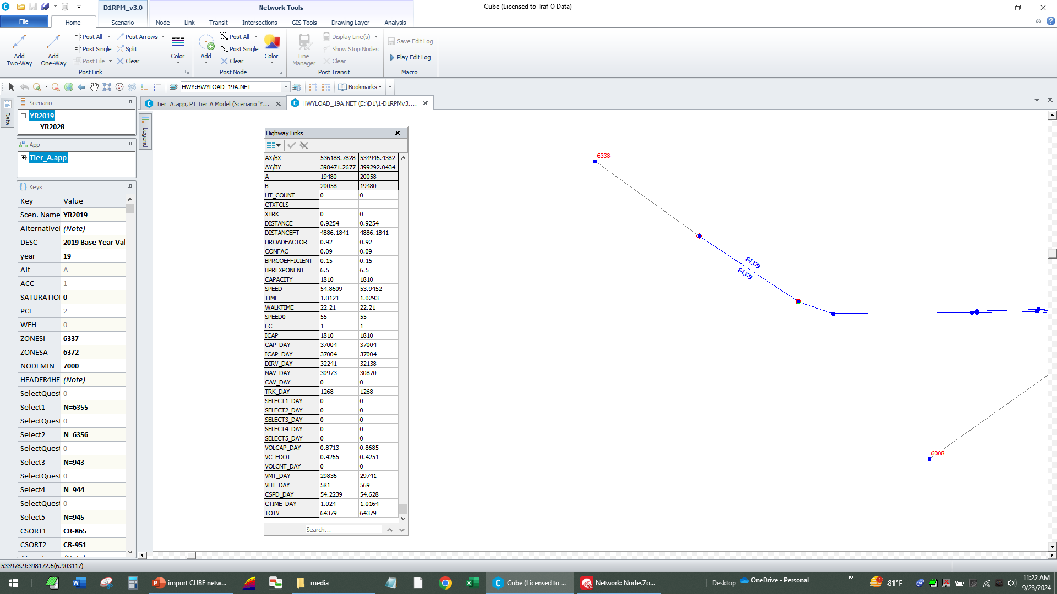
Notes:
Example: 2019 CUBE network. (from E:\D1\1-D1RPMv3.0 for deficiency plots-unzip\D1RPMv3.0 for deficiency plots\D1RPMv3.0\ ) NOTE: note the value for model key ZONESA, which is 6372 NOTE: in CUBE export links and nodes as shapefiles.

Slide 3
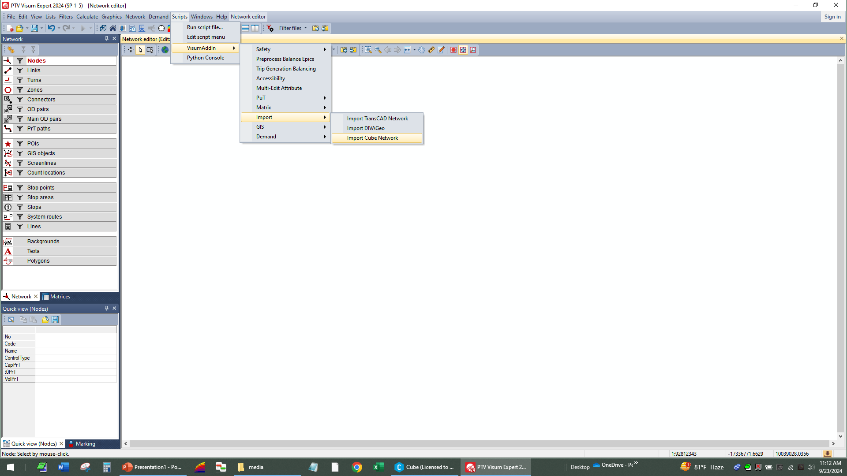
Notes:
PTV VISUM import for Cube Network

Slide 4
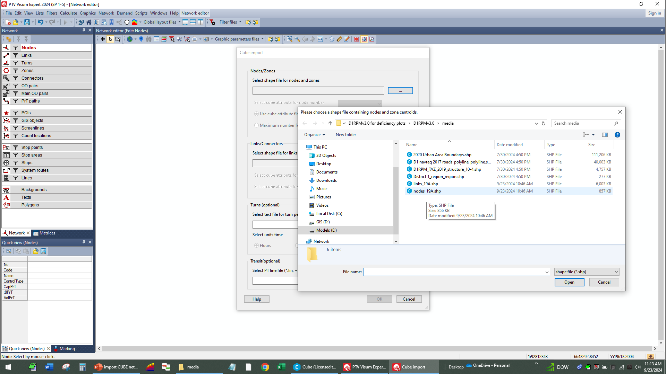
Notes:
Select nodes shapefile
NOTE: you will add 6372 to “maximum number of zones

Slide 5
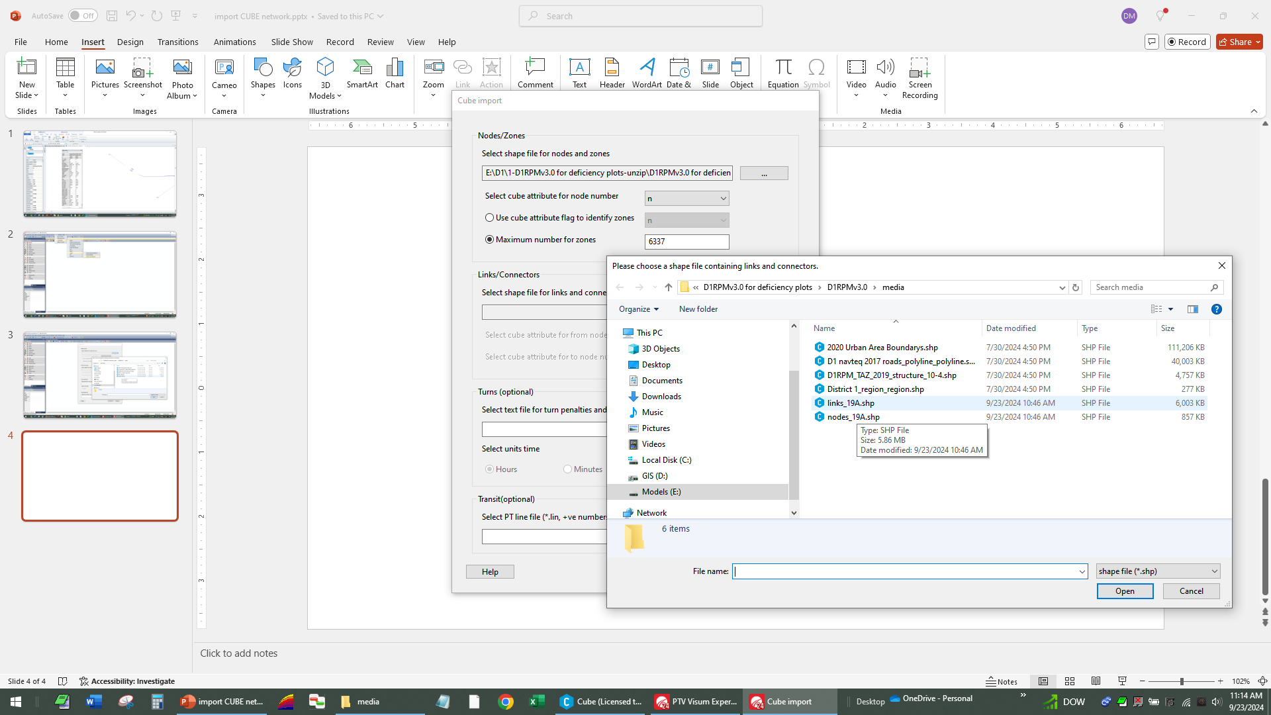
Notes:
Import links shapefile

Slide 6
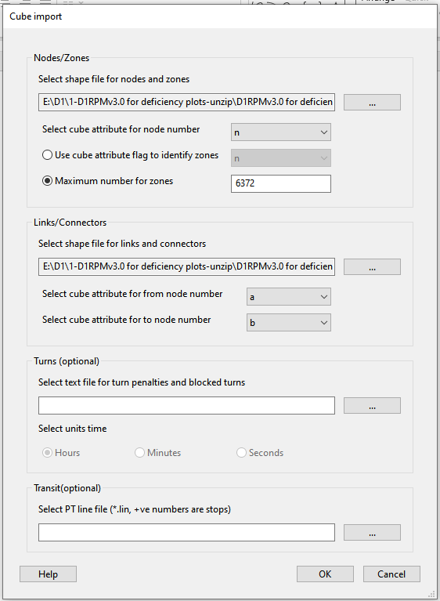
Notes:
NOTE: select A as from-node and B as to-node and select OK

Slide 7
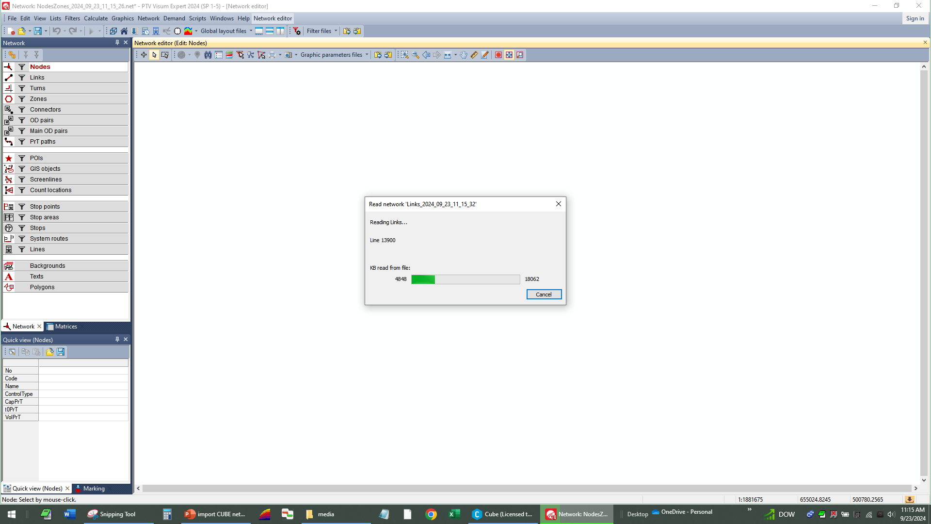
Notes:
Progress window pop-up

Slide 8
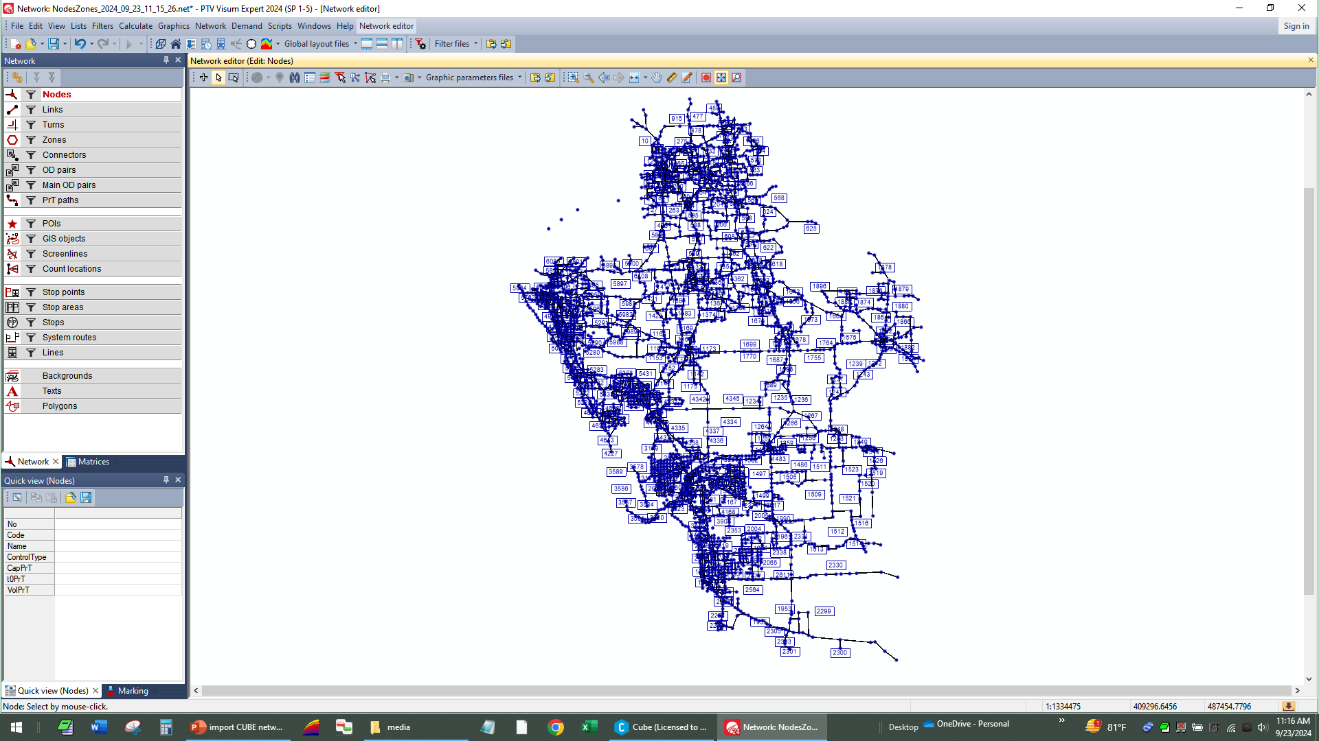
Notes:
Imported model network, but it is not linked to any coordinate system so it will not overlay any maps in Visum.

Slide 9
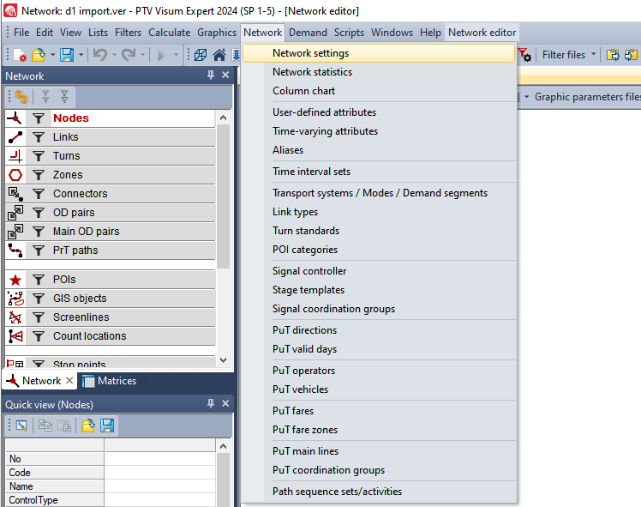
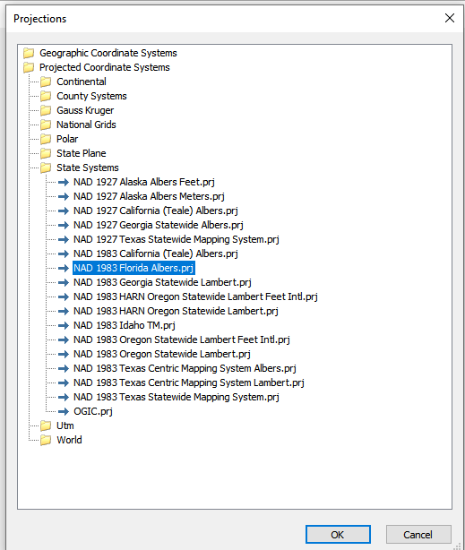
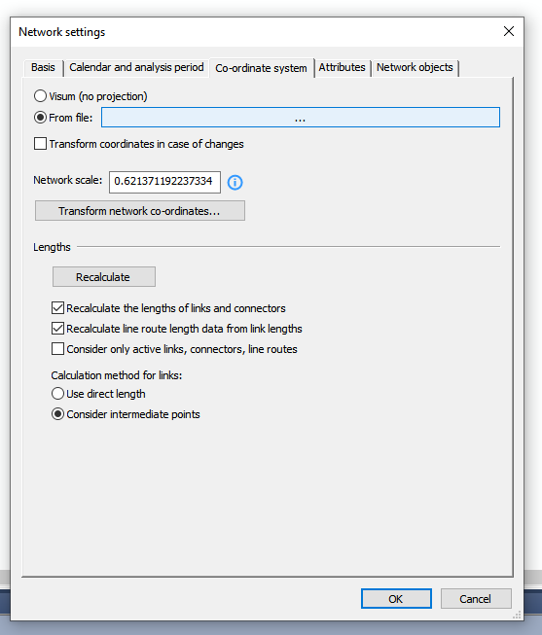
Notes:
Select: Network>Network Settings>Co-ordinate system and “from file:” and select the highlighted projection.
Be sure to unselect the "Transform coordinates…” box.

Slide 10
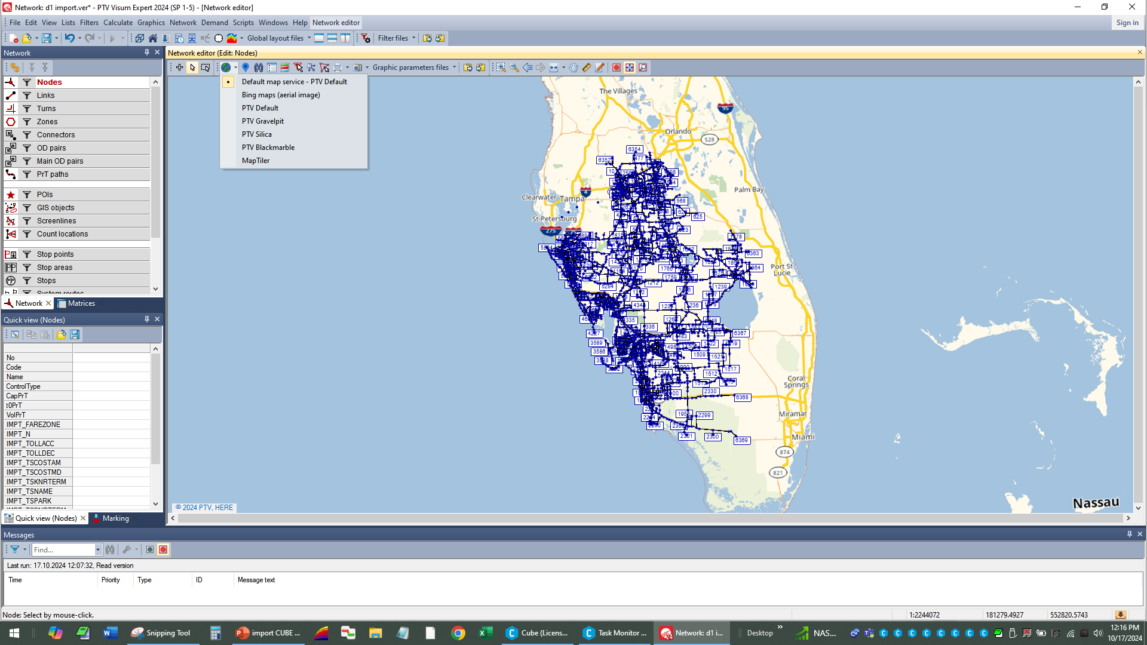
Notes:
Now the model will overlay the default map as shown under the “world” drop-down list.

Slide 11
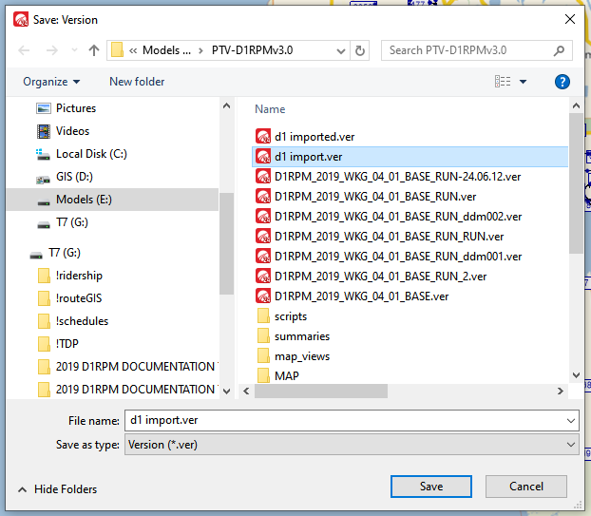
Notes:
At this point it would be a good idea to save the model version file, so you can return to this point in the future, if needed.

Slide 12
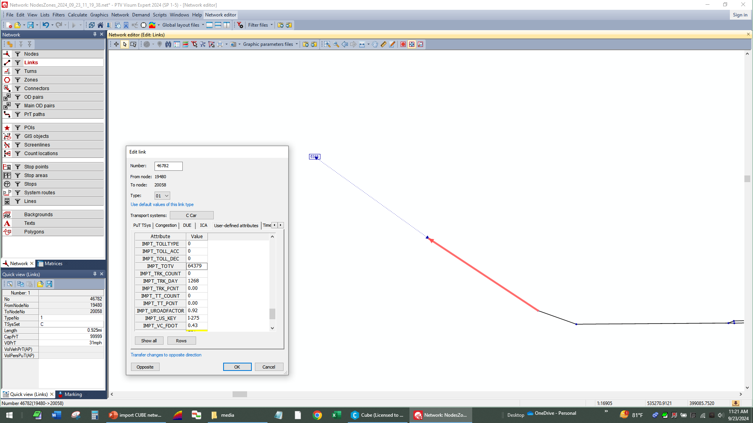
Notes:
You may post values ( BARS ) as usual in VISUM. Here the selected link from the CUBE assignment shows imported values as “IMPT_”+fieldname NOTE: total volume matches the original CUBE model network.

